Slide 1

NLP and Machine Learning exploration of mental health subreddits March 2020
Coronanxiety:

Slide 2

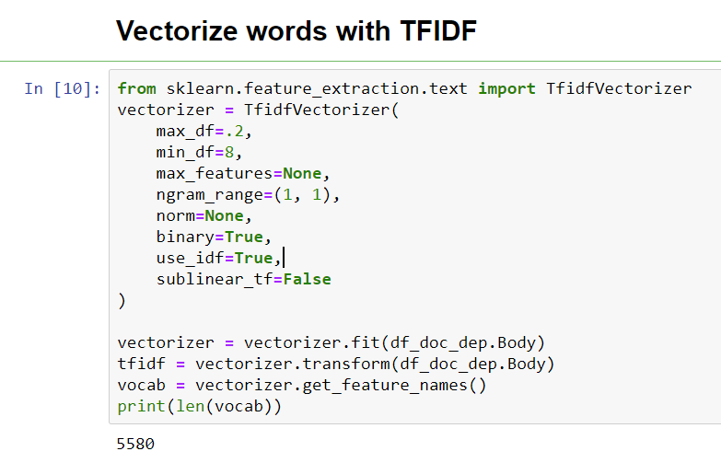





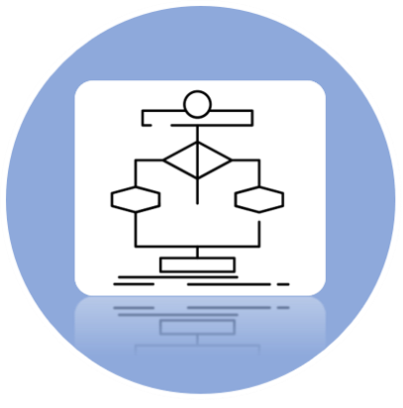





Unigrams
Problem Statement
Data Capturing
Feature Extraction
Algorithm Selection
Data Cleaning
Conclusion

Slide 3
5 Horsemen of the Apocalypse:
Heather Saul
Robert R Cox Jr.
Jennifer Tritle
Seung min Yoo
Aydin Jalilov

Slide 4
Our Questions:
To what degree are subredditers in the r/COVID19_support group rhetorically similar to r/Anxiety & r/Depression subredditers?
In March of 2020 do people in the r/Anxiety & r/Depression subreddits show concern about the virus/lockdown?
Are people in the r/COVID19_support group experiencing something closer to Anxiety or Depression?
These questions are inspired by an emerging body of literature in Psychology and Sociology that use NLP, Big Data, and machine learning to study mental health.
“Recent advances in big-data analytics, machine learning, and natural language processing may make possible the extraction of indicators of mental illness from…word choices, syntactic constructions, and turns of phrase. Several studies have demonstrated that psychological characteristics of an individual can be recovered from analyses of people’s everyday language.”
–Robert Thorstad

Slide 5

COVID19_Support
Subreddit submissions
pulled from pushshift.io
Depression
Anxiety

Slide 6
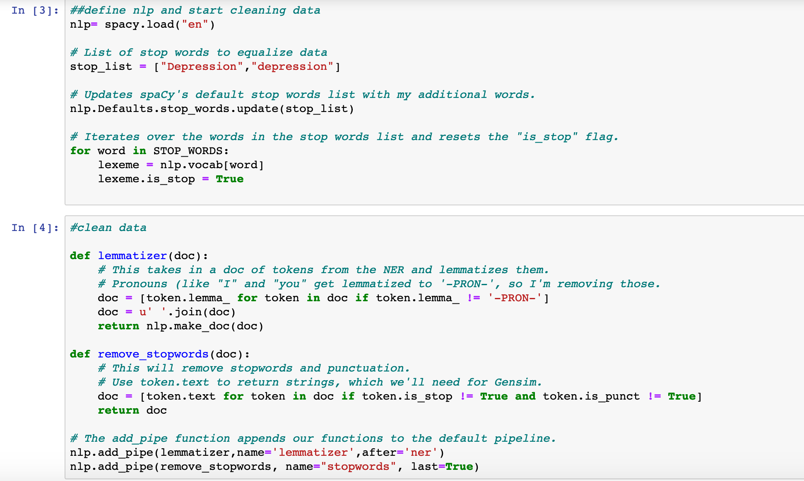

Tokenize
Data Cleaning
Lemmatize
Remove
Stop-words

Slide 7
Tokenize
Data Cleaning
Lemmatize
Remove
Stop-words

Slide 8


Slide 9
Feature Extraction

Slide 10
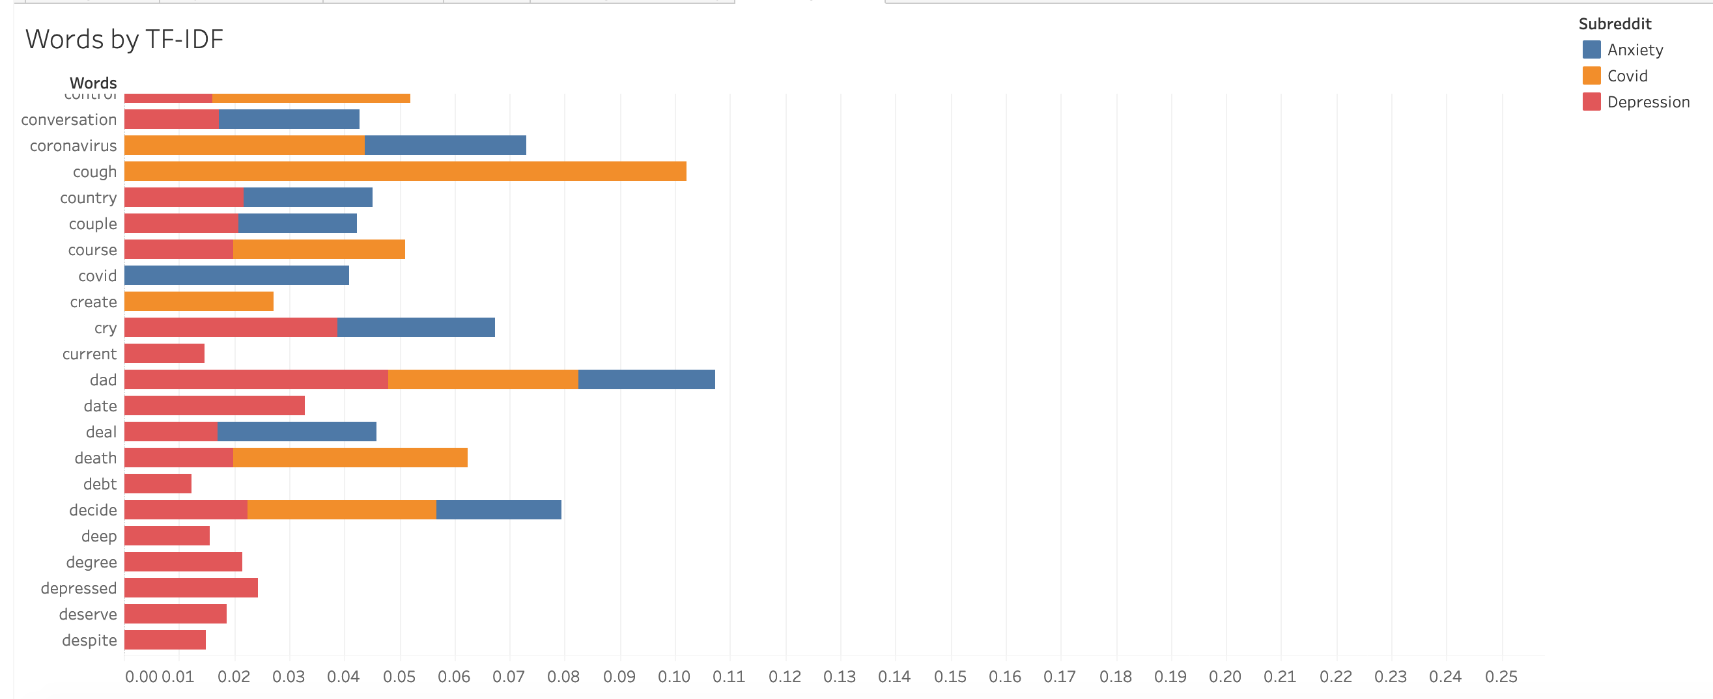
https://public.tableau.com/views/FinalHorsemenTableauTinkering/AnxietyWords?:display_count=y&publish=yes&:origin=viz_share_link

Slide 11
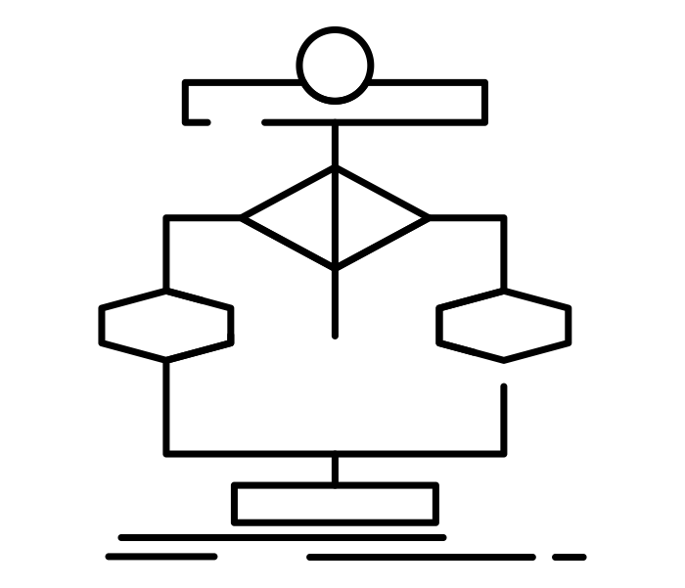
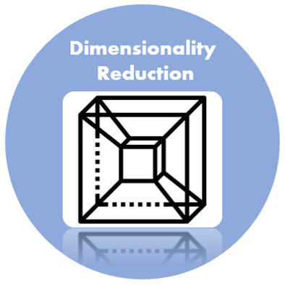
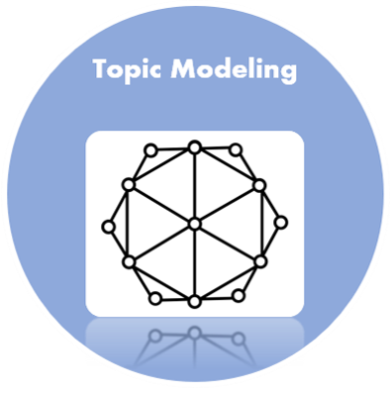
ML Semantic Similarity

Slide 12
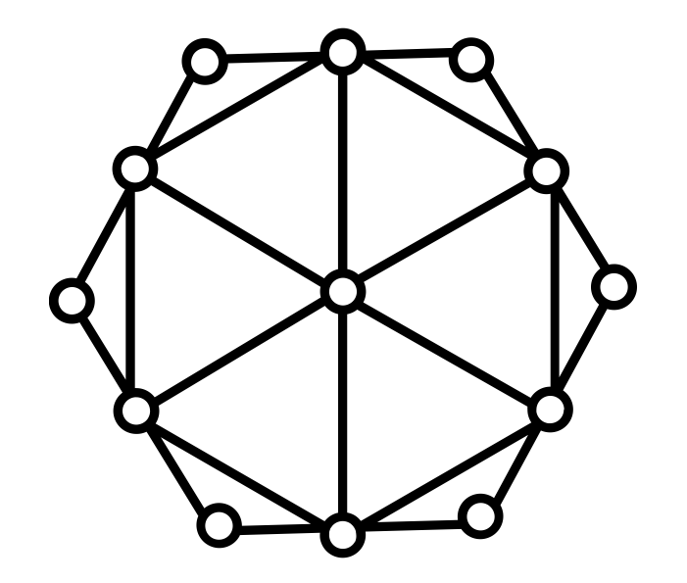
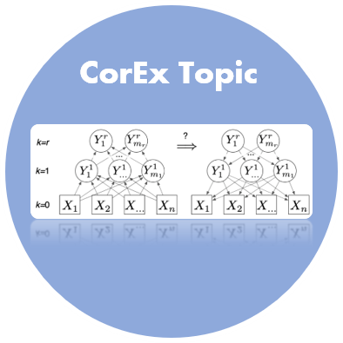
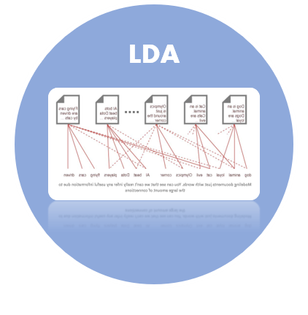
LDA imagines a fixed set of topics. Each topic represents a set of words. And the goal of LDA is to map all the documents to the topics in a way, such that the words in each document are mostly captured by those imaginary topics.
Topic Modeling
This framework learns maximally informative topics through an information-theoretic framework. It naturally generalizes to hierarchical and semi-supervised extensions with no additional modeling assumptions. Word-level domain knowledge can be flexibly incorporated within CorEx through anchor words with minimal human intervention.

Slide 13
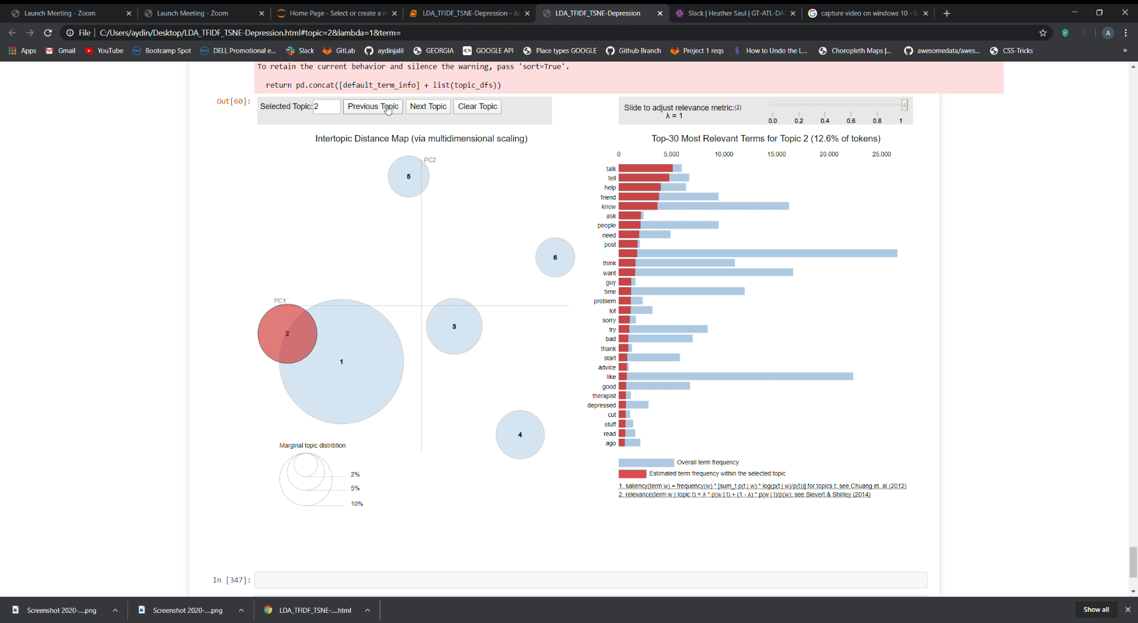
Topic Modeling-LDA

Slide 14
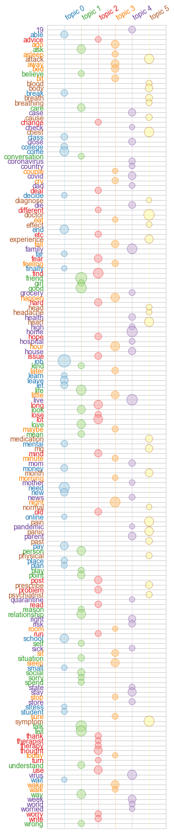
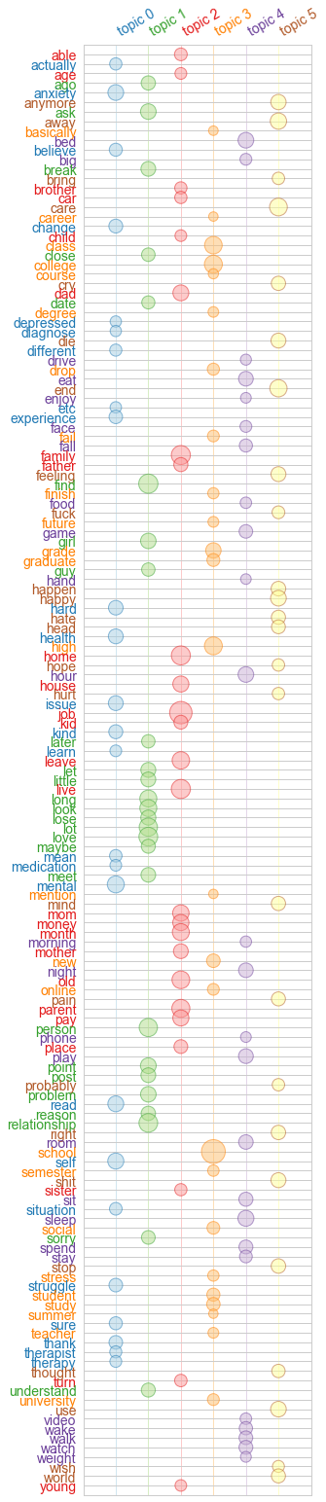
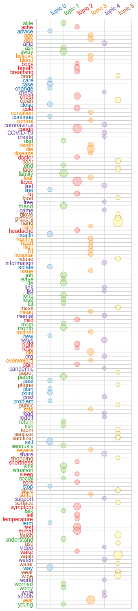
Topic Modeling-CorEx
Anxiety
Depression
COVID

Slide 15
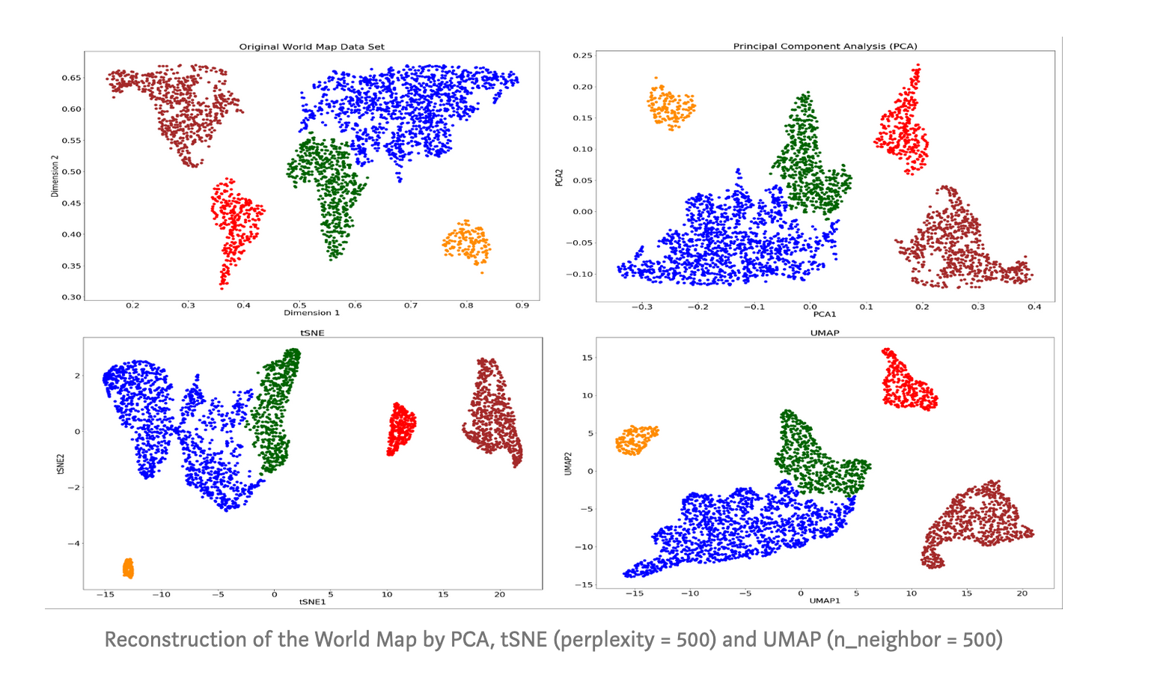

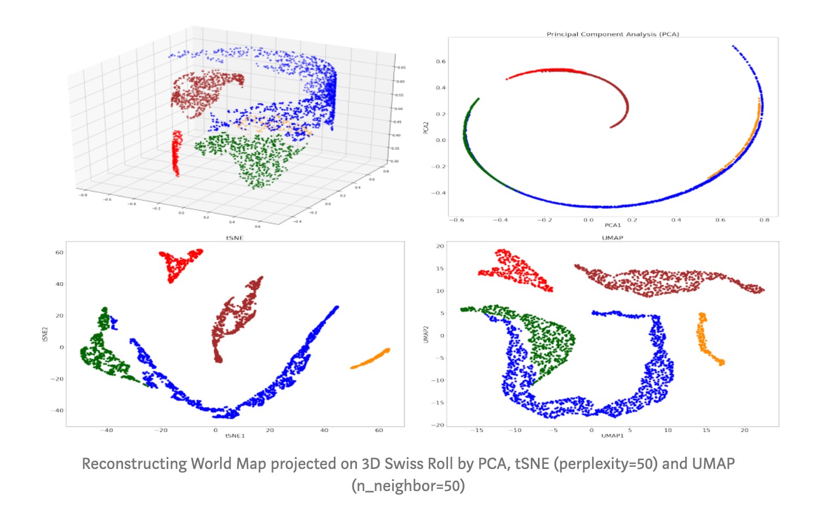
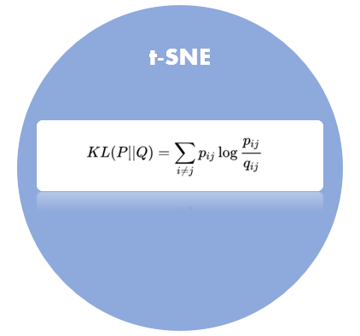
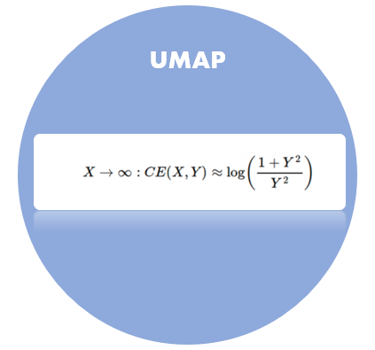
Dimensionality
Reduction

Slide 16
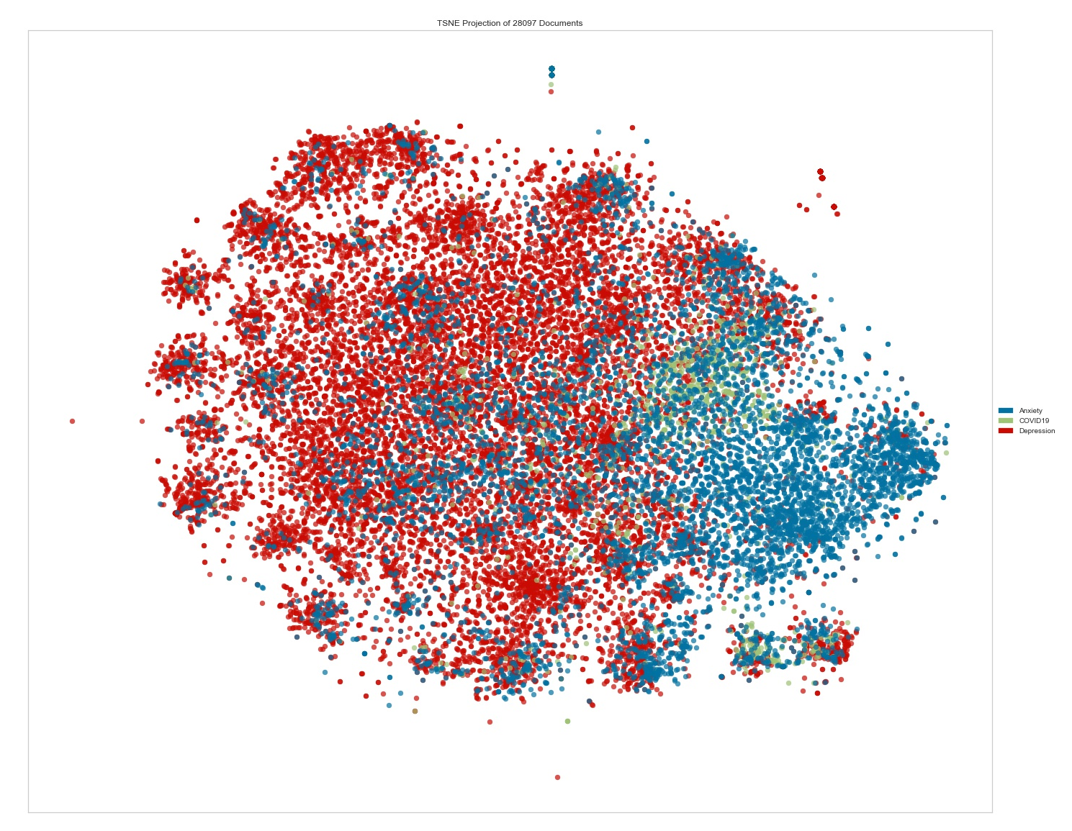
t-SNE

Slide 17
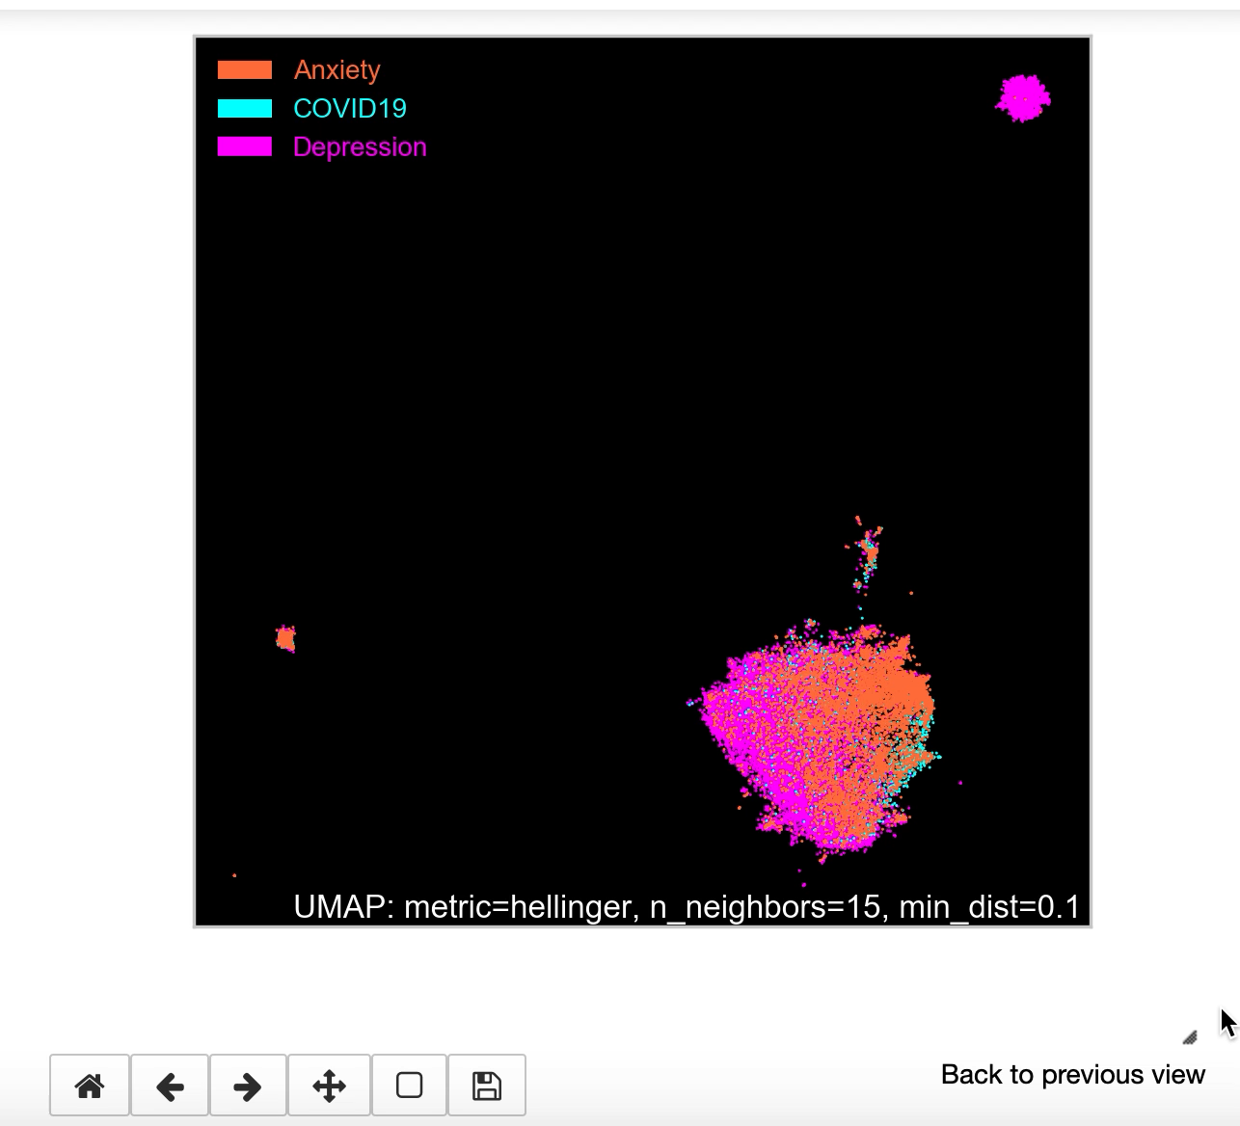
UMAP

Slide 18

Evaluation

Slide 19
Topic Modeling
Comparison
Anxiety
Depression
COVID
LDA | CorEx Topic
feel, like, know, want, think, time, thing, people | tell ,way ,lot ,long ,happen ,point ,mind ,thought problem ,away
feel, like, attack, panic, day, start, time, bad; | job ,life ,need ,find ,end ,month ,mental ,therapy health ,depression
work, job, home, know, day, week, live, virus | friend ,talk ,good ,school ,person ,relationship ,ask ,look ,love ,social
mg, medication, doctor, help, med, prescribe, effect, try | home ,live ,family , virus ,leave ,parent ,house ,stay ,old , die
movie, water, ok, bat, use, watch, dentist, age | heart ,chest ,symptom ,attack ,pain ,panic ,night ,sleep ,wake ,doctor
sex, cough, fever, throat, temperature, pregnant, earthquake, condom | mg ,prescribe, medication ,effect ,dose ,med ,psychiatrist ,zoloft ,lexapro ,xanax
LDA | CorEx Topic
feel, like, want, know, life, think, thing, time | mental ,self ,anxiety ,health ,issue ,hard ,kind ,change ,struggle ,experience
talk, tell, help, friend, know, ask, people, need | find ,love ,relationship , person ,long ,look ,point ,ask ,problem ,girl
school, year, friend, parent, time, start, college, mom | job ,live ,family ,home ,parent ,old ,leave ,month ,mom ,money
day, sleep, week, eat, night, bed, hour, room | school ,college ,high ,class ,grade ,new ,study ,student ,graduate ,social
mental, health, medication, anxiety, help, therapy, med, doctor | sleep ,bed , play ,eat ,night ,room ,sit ,spend ,watch , game
job, work, money, pay, live, home, house, month | care ,end ,away ,happy ,cry ,anymore ,shit ,feeling ,die ,hate
LDA | CorEx Topic
know, feel, like, work, people, home, want, live | family ,life ,friend , month ,social, situation ,self, mean ,love ,worry
people, day, work, feel, know, like, time, think | year ,old ,risk ,dad ,worried, sick ,parent mother ,die ,fear
work, virus, time, know, day, people, like, help | away ,today ,tell ,hour ,leave ,care ,house ,wake ,night ,understand
people, feel, like, year, time, know, life, thing | health ,information ,news ,find ,share ,org ,covid ,mental ,coronavirus ,support
like, feel, people, anxiety, day, symptom, think, know | wipe, food ,use ,store ,clean ,grocery, place ,door ,wear ,mask
people, feel, virus, know, school, day, year, anxiety | cough ,fever ,throat ,chest ,symptom ,hand ,nose ,test ,wash ,breath
Conclusion: Topics produced by Corex Topic were less repetitive and more coherent. The additional functionality to nudge topics that are “undercooked” or “overcooked” also improved the results.

Slide 20
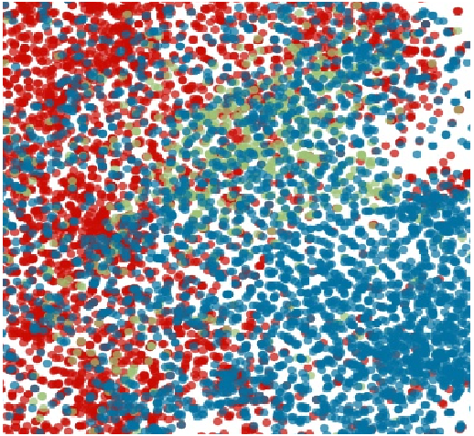
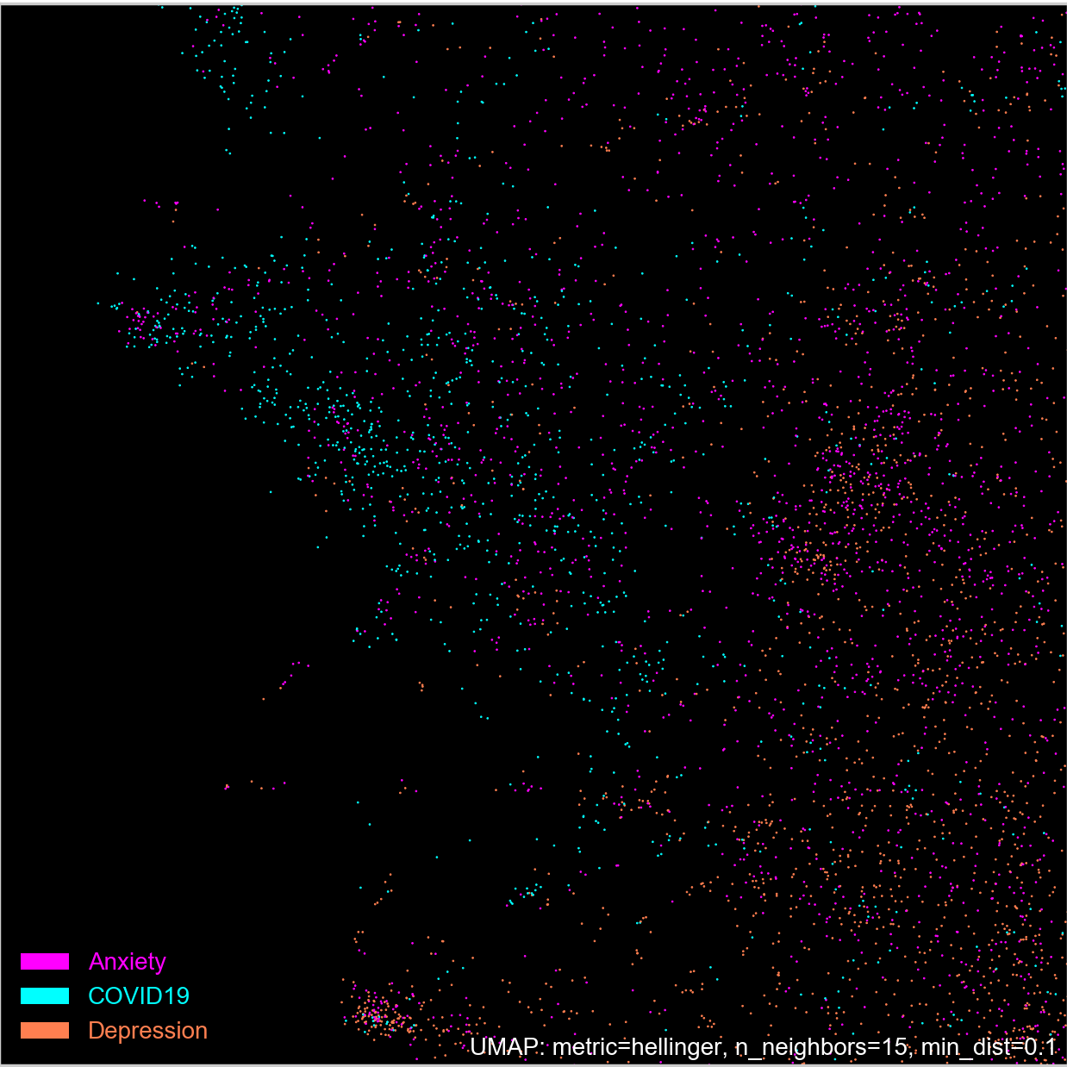
Dimensionality Reduction Comparison
t-SNE
UMAP
Conclusion: Umap and t-SNE are similar, but umap appears to perform better at showing the distances between points and preserving the global structure of the data.

Slide 21
Final Thoughts…
Caveat: We are not diagnosing anyone and recognize that this data is from a very short period of time. However, our results indicate that with a large, longitudinal data set it might be possible to understand how Coronavirus is impacting the mental health of subredditers through NLP and machine learning.
Results: In March of 2020, subredditers in the Anxiety subreddit were much more concerned about Coronavirus than in the Depression subreddit. In addition, COVID19 support subredditers used language more rhetorically similar to Anxiety subredditers than those in the Depression subreddit.
Further Questions: Future research might look up usernames to see how much actual overlap there is in users posting during this time in the COVID19_support and other mental health subreddits. In addition, as stated previously, these research methods would benefit from a dataset with a longer time scale.

Slide 22
References:
Big Data and Psychology:
https://link.springer.com/article/10.3758/s13428-019-01235-z
https://www.ncbi.nlm.nih.gov/pmc/articles/PMC5915669/
https://www.nature.com/articles/srep45141
https://www.researchgate.net/publication/328899704_Not_Just_Depressed_Bipolar_Disorder_Prediction_on_Reddit
Reddit API:
https://medium.com/@RareLoot/using-pushshifts-api-to-extract-reddit-submissions-fb517b286563
NLP, Topic Modeling, Dimensionality Reduction:
https://programminghistorian.org/en/lessons/analyzing-documents-with-tfidf
https://medium.com/@sherryqixuan/topic-modeling-and-pyldavis-visualization-86a543e21f58
https://nlpforhackers.io/word-embeddings/
https://towardsdatascience.com/topic-modeling-and-latent-dirichlet-allocation-in-python-9bf156893c24
https://medium.com/nanonets/topic-modeling-with-lsa-psla-lda-and-lda2vec-555ff65b0b05
https://theintelligenceofinformation.wordpress.com/2016/12/06/topic-modeling-latent-dirichlet-allocation-vs-correlation-explanation-alternative/
https://towardsdatascience.com/tsne-vs-umap-global-structure-4d8045acba17
http://vis.stanford.edu/papers/termite

